Slide 1
SFM
Smart facility management

Slide 2
Smart Facility Management

Slide 3
Project management

Slide 4
Taxonomy

Slide 5
WBS

Slide 6
GANNT

Slide 7
Risk management

Slide 8
SFM introduction

Slide 9
Opportunity (Study case)

Slide 10
Current HVAC

Slide 11
Stakeholders

Slide 12
Survey analysis

Slide 13
CONOPS
PUT SYSTEM OVERVIEW

Slide 14
Design concepts
State the three design concepts
PUT Selection matrixes

Slide 15
System requirement
Stakeholder Requirement | System Requirement | COTS | Classification
Monitor and adjust temperature | Collect temperature data for display and computation | Temperature Sensor, Microcontroller | Must to have
Monitor humidity | Collect humidity data for display and computation | Humidity Sensor, Microcontroller | Must to have
Monitor and adjust CO2-level | Collect CO2-level data for display and computation | CO2 Sensor, Microcontroller | Must to have
Ease of use, Accessibility | Provide UI to interact with user | Touchscreen, Microcontroller | Must to have
Ease of use | UI reaction logic, Communication with sensors, Data calculation, HVAC control signal output. | Microcontroller | Must to have
Adjust indoor environment, Compatibility with existing HVAC system, Ease of deployment | Connect to HVAC controller | 4-Channel Relay Module | Must to have

Slide 16
System requirement
Stakeholder Requirement | System Requirement | COTS | Classification
Adjust humidity | Increase air humidity | Humidifier | Nice to have
Ease of use | Change the configuration of indoor temperature according to time. | Microcontroller | Nice to have
Energy saving, Ease of use | Automatically switch to economy mode | Motion Sensor | Nice to have
Ease of use | Collect weather information from internet | WIFI module, Weather forecast website | Desirable
Accessibility, Ease of use | To tell information and setting about HVAC system using voice for blind people or people in dark room. | WIFI module, Voice interaction server | Desirable
Cost of implementation | Give user access to get information and setting HVAC system by website. | WIFI module, Website | Desirable
Ease of use | Give user access to get information and setting HVAC system by mobile phone. | WIFI module, Apps | Desirable

Slide 17
Functional analysis

Slide 18
Function Block Diagram

Slide 19
Function Block Diagram

Slide 20
IDEF0

Slide 21
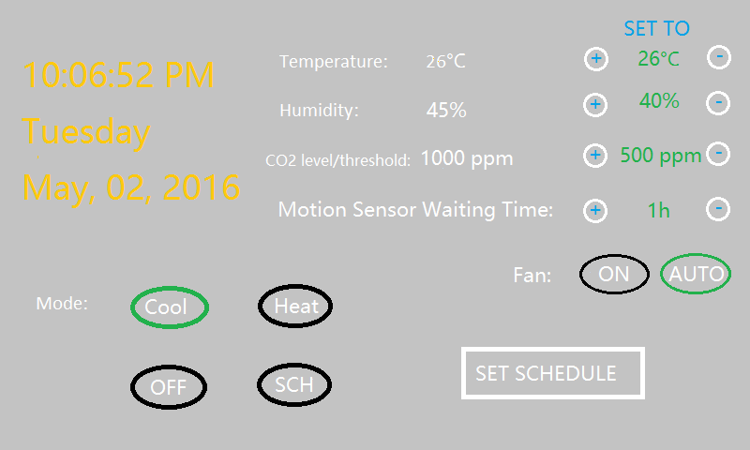
User Interface

Slide 22
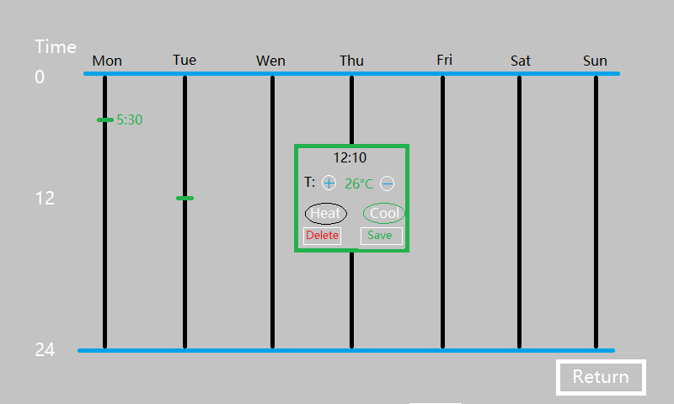
User Interface

Slide 23
HW block diagram
PUT system overview of HW blocks

Slide 24
Bill of materials (BoM)
PUT BoM table

Slide 25
Documents
PM
BRR
SRR
CONOPS
SDR
PDR
CDR

Slide 26
Summary

Slide 27
References

